Slide 1
COMP 421: Files & Databases
Lecture 0: Logistics, policies, scheduling, Project 0…
and maybe some actual material

Slide 2
WaitList
2
I cannot make waitlist guarantees at this time
To improve your chances of getting into the class (though not a guarantee), stay in the class and complete P0.
Waitlist decisions will be made according to some fair metric, so please do not email us specific requests. We will not return these emails.

Slide 3

Course Overview
3
This course is about the design/implementation of database management systems (DBMSs).
This is not a course about how to use a DBMS to build applications or how to administer a DBMS.
  See SILS, STOR, and more
  You all have seen my memo at this point.

Slide 4
Course Pages
4
Course Schedule, Syllabus, Policies, Projects: Course Web Page

Slide 5
Course Pages
5
Project submission and autograding: Gradescope

Slide 6
Course Pages
6
Mostly just links and grade/roster management: Canvas

Slide 7
Grading
7
Projects (70%)
  Project 0 (10%)
  Project 1 (20%)
  Project 2 (20%)
  Project 3 (20%)
Midterm Exam (10%)
Final Exam (15%)
Participation (5%)

Slide 8
Projects
8
All projects will use the CMU DB Group BusTub academic DBMS.
  Written in C++
  Each project builds on the previous one.
We will have at least two bootcamps for getting up to speed on C++
More of these group sessions are possible if these first two are helpful

Slide 9
Late Policy
9
You have a total of four late days to be used for the semester
  Calendar days, not “business days”
No late days for Project 0
We will grant no-penalty extensions due to extreme circumstances (e.g., medical emergencies). These circumstances must be documented with the university. Do not email for an extension without attaching university documentation. We will not reply to emails without documentation.
  If something comes up, please contact the instructors as soon as possible.

Slide 10
Office Hours
Instructors and TAs will hold office hours on weekdays (Mon-Fri) at different times.
Additional meetings can be made by appointment, or if there is overwhelming demand (e.g. project deadline)
We need your help to schedule these, scheduling survey will arrive via email this week

Slide 11
<serious>

Slide 12
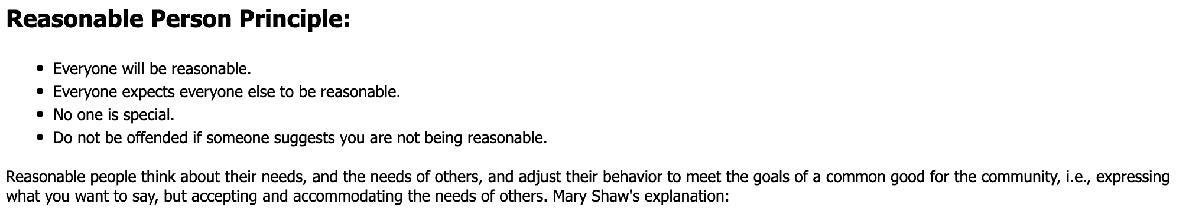
Office Hours: Do’s and Don’t’s
Do:
  Come to office hours or make an appointment
  Discuss material from the lectures/bootcamps/textbook
  Discuss testing/debugging tools to help with projects
  Discuss high-level issues or conceptual questions about the projects
Don’t:
  Ask a TA or classmate to debug your code
  Copy code that isn’t yours (more on this…)
  Act unreasonably towards instructors, TAs, other students

Slide 13
AI Policy
Goal: A realistic, enforceable policy that acknowledges the reality of how humans program computers in 2025
Caveat: still need to teach a course with gradable, right-sized assignments
Policy: the limited use of AI is permitted, but students are wholly responsible for ensuring that their solutions adhere to the course policy on plagiarism
Things that might be ok when working on project:
  High level questions: “how does postgres store large objects?”
  Limited coding assistance “include the library for std::sort”

Slide 14
Some Advice
Don’t get in over your head with the AI generated code
  Especially on Project 0

Slide 15

PLAGIARISM WARNING
15
There is no group collaboration on assignments or exams in this course
Exams are closed book (closed everything)
You may not copy source code from other people or sources
If you choose to use AI, you are responsible for ensuring you are submitting your own work
From the syllabus: “Students are responsible for ensuring that submitted work is not substantially similar to existing publicly or privately available materials”
Plagiarism is an honor code violation. This is your only warning.
  Please ask me (not TAs!) if you are unsure.

Slide 16

One More Thing…
We are using open source course materials, especially BusTub
Make sure your Github fork of BusTub is private
  (follow instructions on site/README)
Making your solutions public (or distributing them in any way) is an honor code violation
But also, its harmful to the CS Ed. Community
And you’ll have to answer to Andy Pavlo who wrote BusTub…

Slide 17
</serious>

Slide 18
Project 0

Slide 19
C++ Bootcamp
19
Need to get up to speed quickly on C++. Three main approaches
  Reading. Links on website to online tutorials, examples, books
  Recitation. Instructor-led sessions to go through C++ features, examples, pitfalls. For students coming from Java / C.
  Writing. Project 0 will give a tour of C++ and the dev environment for the semester. Future projects will be harder.

Slide 20
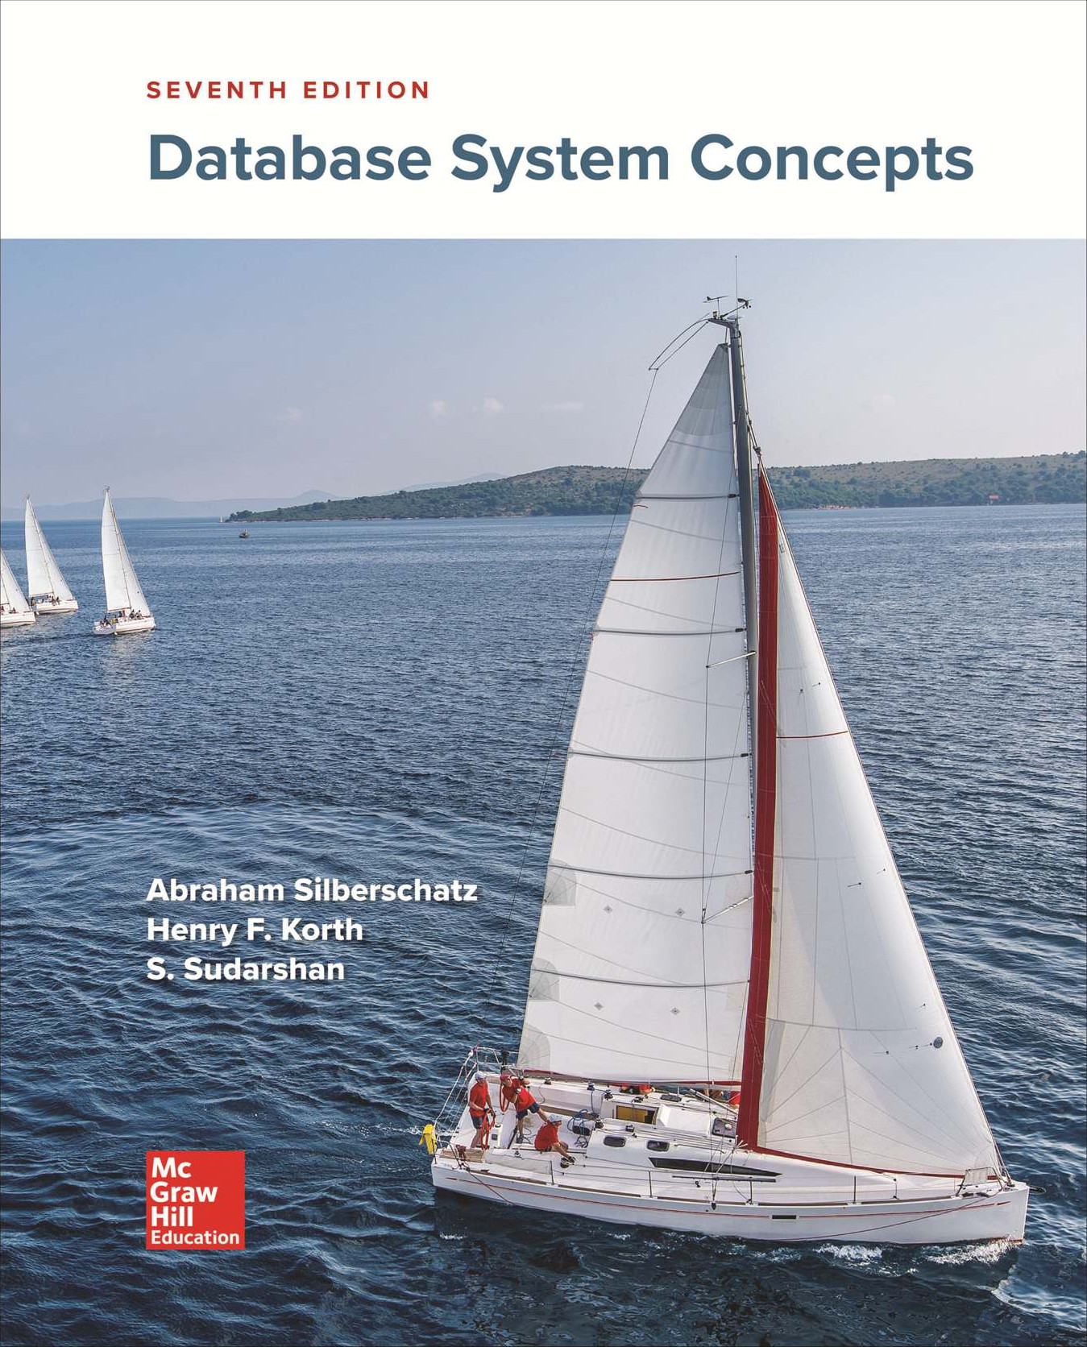
Textbook
20
Database System Concepts
7th Edition
Silberschatz, Korth, & Sudarshan
Official Course Textbook

Slide 21
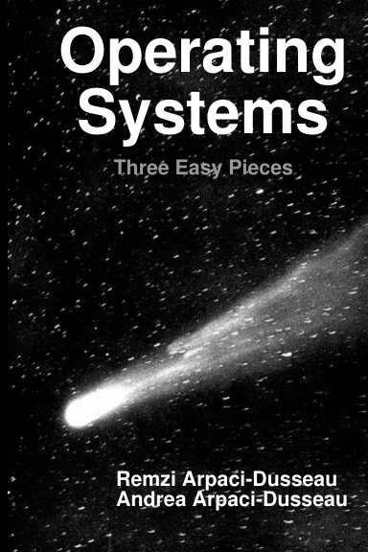
Some other good books
21
Operating Systems: Three Easy Pieces (OSTEP), (Arpaci-Dusseau)²
  Free online at: https://pages.cs.wisc.edu/~remzi/OSTEP/
A Tour of C++, Stroustrup
Effective modern C++, Meyers
Links on website

Slide 22
C++ Bootcamp
22
Need to get up to speed quickly on C++. Three main approaches
  Reading. Links on website to online tutorials, examples, books
  Recitation. Instructor-led sessions to go through C++ features, examples, pitfalls. For students coming from Java / C.
  Writing. Project 0 will give a tour of C++ and the dev environment for the semester. Future projects will be harder.

Slide 23
Bootcamp 1: Week of 8/25
23
Two identical 1 hour sessions (pick one):
8/25 @ 6:30 pm
SN014
8/26 @ 6:30 pm
SN014
Room might change!
We will provide food:
Pizza?
Burritos?
Other?
RSVP Now!

Slide 24
Bootcamp 2
Will do a similar thing on more advanced C++ features
Will coincide with release of Project 1
Will try and incorporate feedback from Bootcamp 1 / Project 0

Slide 25
C++ Bootcamp
25
Need to get up to speed quickly on C++. Three main approaches
  Reading. Links on website to online tutorials, examples, books
  Recitation. Instructor-led sessions to go through C++ features, examples, pitfalls. For students coming from Java / C.
  Writing. Project 0 will give a tour of C++ and the dev environment for the semester. Future projects will be harder.

Slide 26

Project 0 (P0): Goals
26
  Get you started on C++, so you are not surprised later.
  Get you thinking about algorithms and (a bit) about concurrency.
  P0 is about building a HyperLogLog data structure.
    Probabilistic data structure used for sketching in large-scale a distributed DMBSs
    The data structure is cool, but is not really the point
  P0 is published; due 9/3/25 @ 11:59:59.
  No late days allowed for P0.
If you have a bad time on this project, you’re gonna have a bad time in this course

Slide 27
Project 0 (P0): Tips and Tricks
27
  Start now so you can get the most out of Bootcamp 1 and be ready when these projects get harder
  Follow instructions on either the P0 page or the BusTub github to set up your dev environment and build BusTub.
    In general, we won’t ask you to mess with the build system (cmake), but you should understand what the different options do
  Learn how to use the GTest testing framework used for testing BusTub. HINT: You will probably have to run the hyperloglog_test suite locally, and look into test/primer/hyperloglog_test.cpp to figure out how to pass all tests.
    Future projects might not make all tests visible. Writing your own tests will become super helpful.

Slide 28
<course>

Slide 29
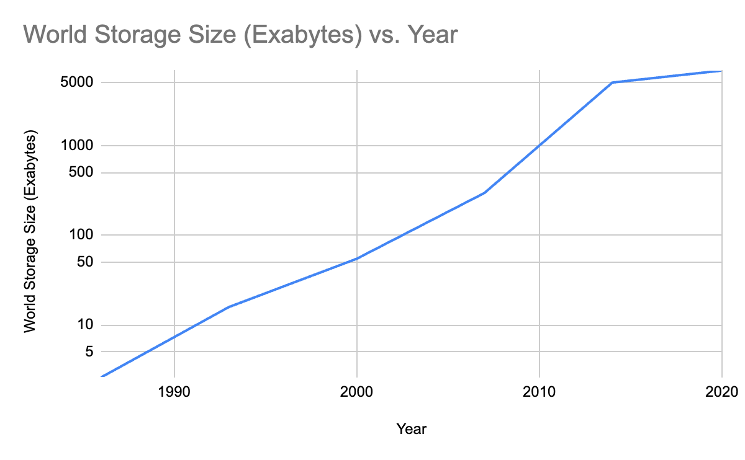
High-level Problem

Slide 30
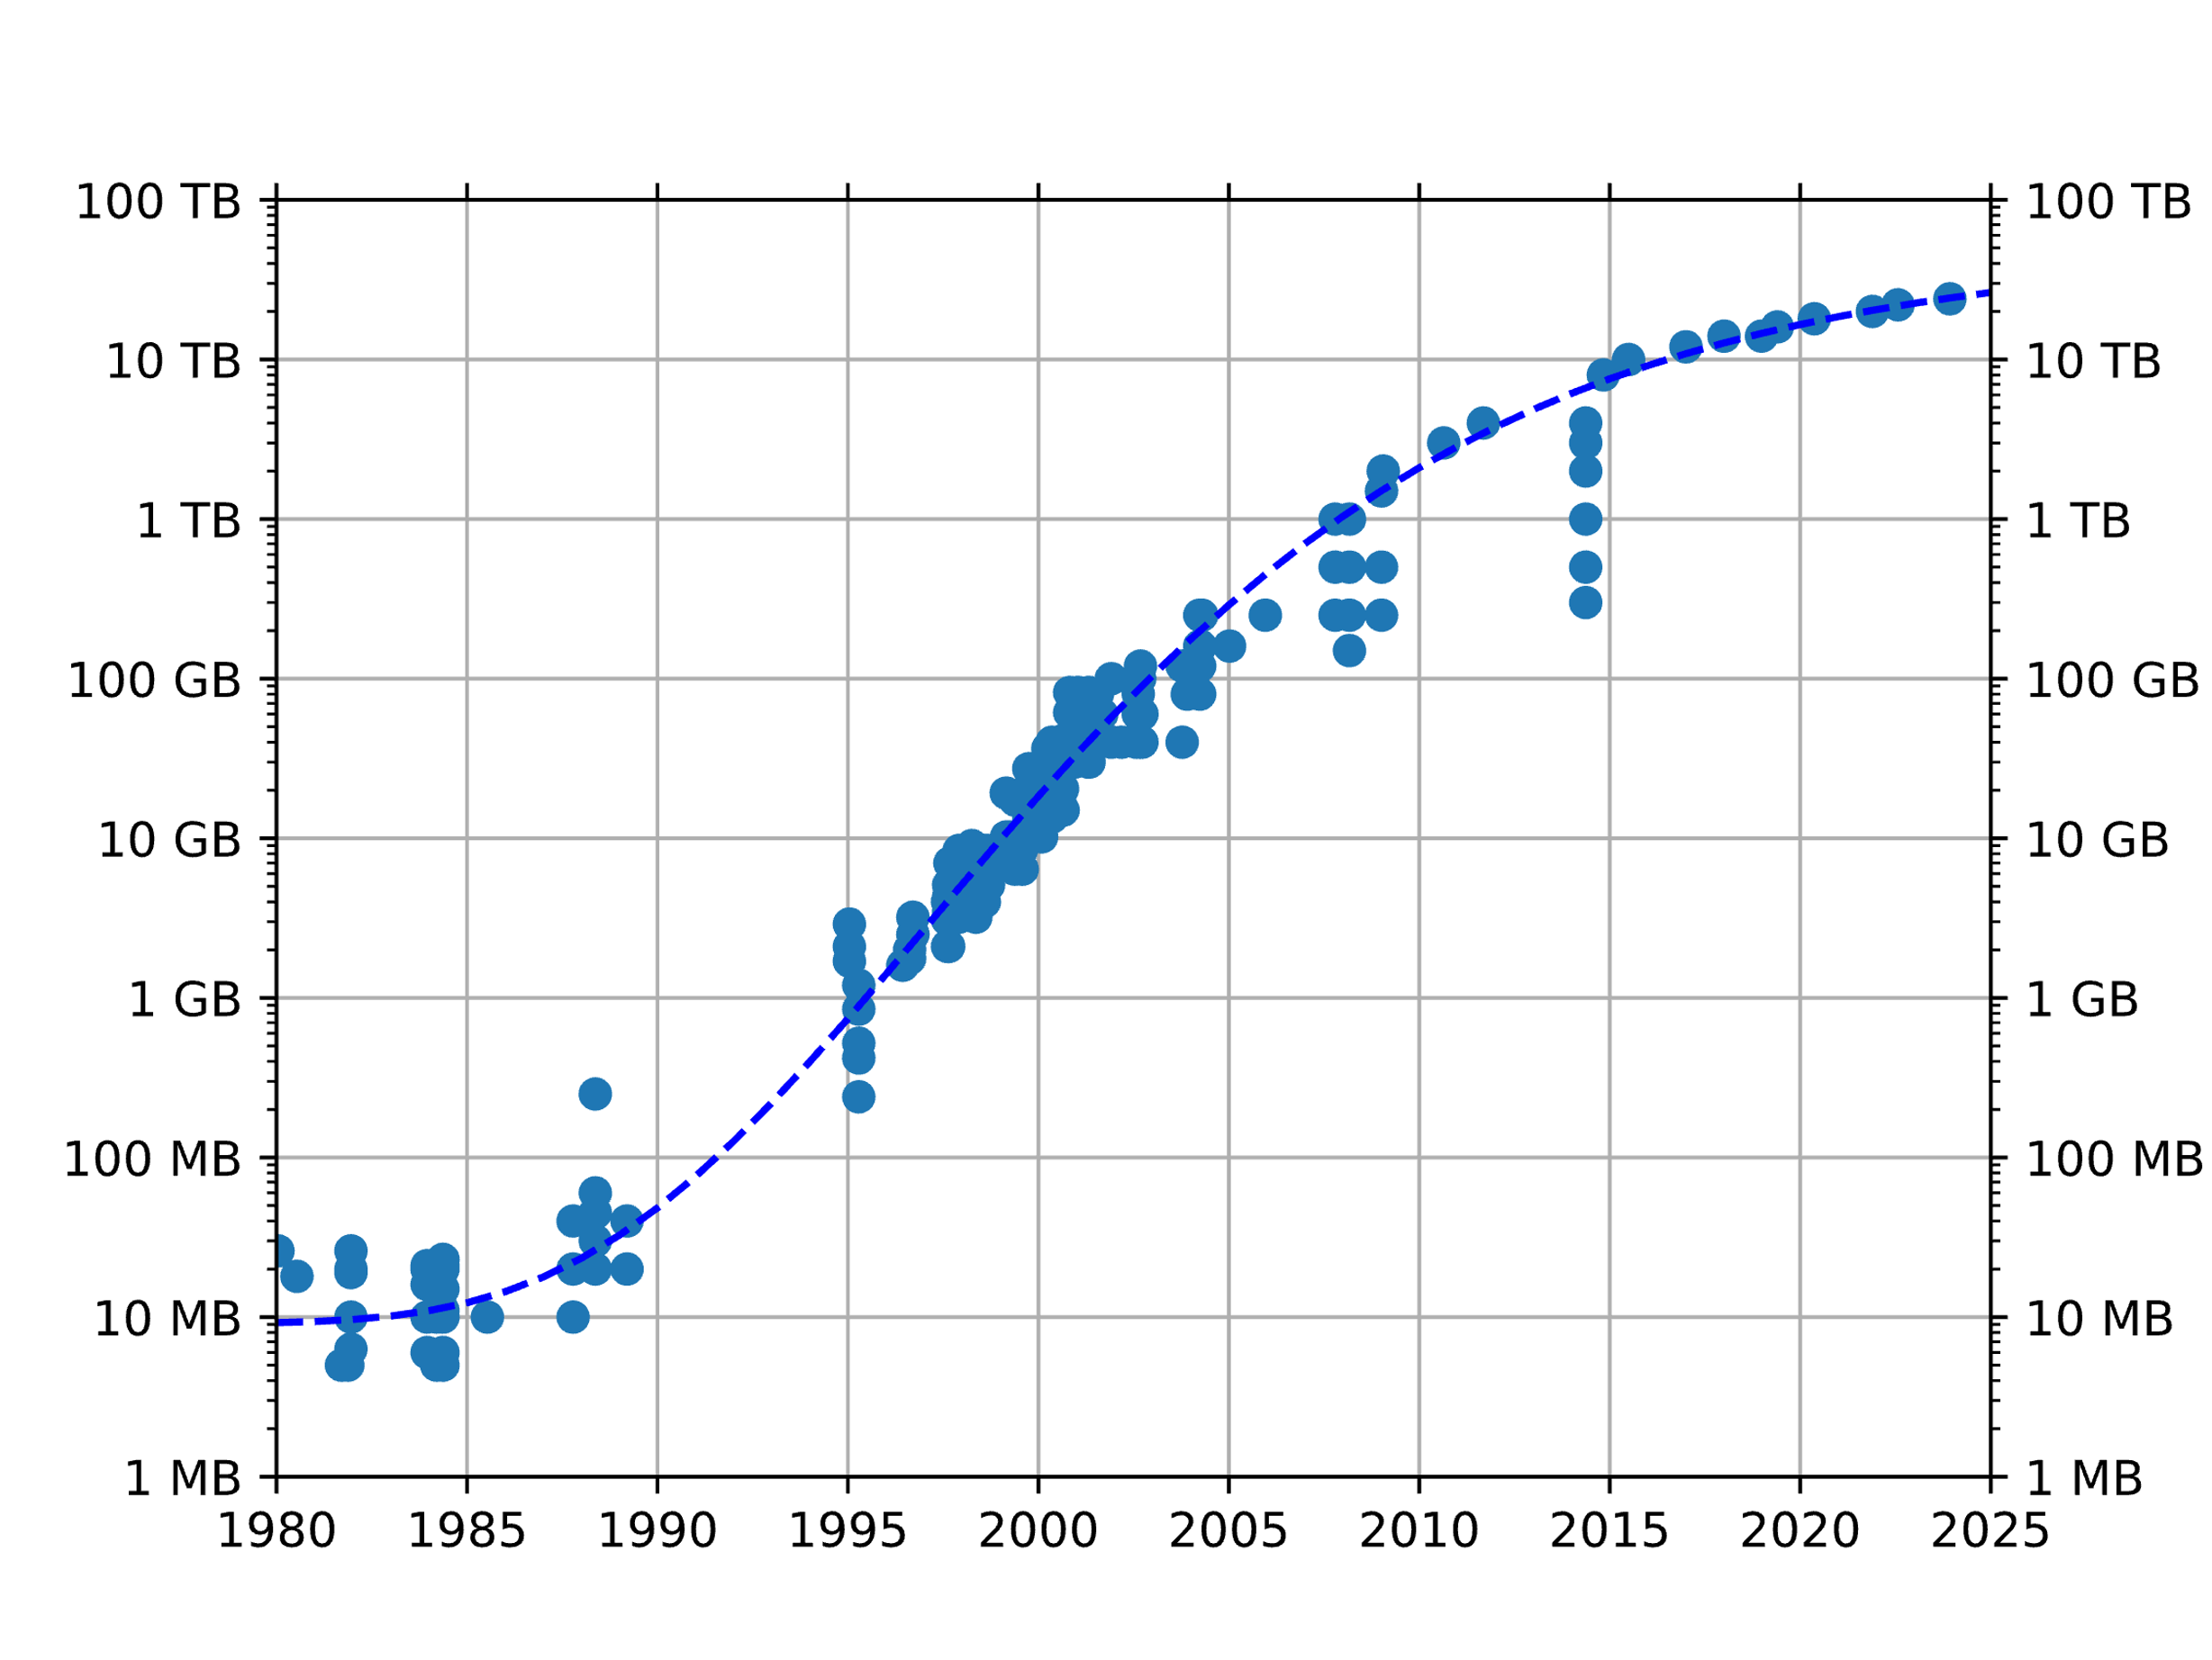
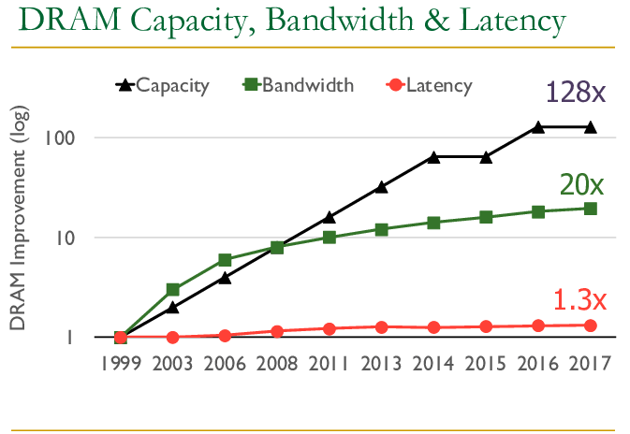
High-level Problem
HDD Capacity
Memory/storage have grown
Storage capacity = ~100x DRAM remains common
Today: 10’s – 100’s GB DRAM : 1’s -10’s TB of SSD/HDD per server

Slide 31
Latency Numbers Every Programmer Should Know
31
Or: the whole story of COMP 421 in one table
1 ns | L1 Cache Ref
4 ns | L2 Cache Ref
100 ns | DRAM
16,000 ns | SSD
2,000,000 ns | HDD
~50,000,000 ns | Network Storage
1,000,000,000 ns | Tape Archives
1 sec
4 sec
100 sec
4.4 hours
3.3 weeks
1.5 years
31.7 years
Source: Colin Scott

Slide 32
Latency Numbers Every Programmer Should Know
32
1 ns | L1 Cache Ref
4 ns | L2 Cache Ref
100 ns | DRAM
16,000 ns | SSD
2,000,000 ns | HDD
~50,000,000 ns | Network Storage
1,000,000,000 ns | Tape Archives
Volatile
Non-volatile, single node
Non-volatile, off-node
Source: Colin Scott

Slide 33
The Database Dilemma
  Want persistent storage and durable updates (storage), but also fast, complex data processing (memory)

Slide 34
Latency Numbers Every Programmer Should Know
34
Capacity
$$$$$
1 ns | L1 Cache Ref
4 ns | L2 Cache Ref
100 ns | DRAM
16,000 ns | SSD
2,000,000 ns | HDD
~50,000,000 ns | Network Storage
1,000,000,000 ns | Tape Archives
~ 100 KB per core
~ 2 MB per core
~ 100’s GB
Cost
Per
Byte
~ 1’s TB
~ 10’s TB
PBs per AWS Avail. Zone
$
Multi-zone backups
Source: Colin Scott

Slide 35
The Database Dilemma
  Want data persistence and durable updates (storage), but also fast/complex data processing (memory)
  Want to process a drive worth of data (e.g. TB) using a server’s worth of memory (e.g. 64 GB)

Slide 36
Latency Numbers Every Programmer Should Know
36
10’s – 100’s cores per server
$$$$$
1 ns | L1 Cache Ref
4 ns | L2 Cache Ref
100 ns | DRAM
16,000 ns | SSD
2,000,000 ns | HDD
~50,000,000 ns | Network Storage
1,000,000,000 ns | Tape Archives
~ 100 KB per core
~ 2 MB per core
~ 100’s GB
Cost
Per
Byte
~ 1’s TB
~ 10’s TB
PBs per AWS Avail. Zone
$
Multi-zone backups
Source: Colin Scott

Slide 37
Latency Numbers Every Programmer Should Know
37
Maybe 100’s of servers per warehouse
$$$$$
1 ns | L1 Cache Ref
4 ns | L2 Cache Ref
100 ns | DRAM
16,000 ns | SSD
2,000,000 ns | HDD
~50,000,000 ns | Network Storage
1,000,000,000 ns | Tape Archives
~ 100 KB per core
~ 2 MB per core
~ 100’s GB
Cost
Per
Byte
~ 1’s TB
~ 10’s TB
PBs per AWS Avail. Zone
$
Multi-zone backups
Source: Colin Scott

Slide 38
The Database Dilemma
  Want data persistence and durable updates (storage), but also fast/complex data processing (memory)
  Want to process a drive worth of data (e.g. TB) using a server’s worth of memory (e.g. 64 GB)
  To leverage available compute, need concurrency at every level: intraquery, interquery, single-node, distributed database (multi-node)
  Want abstractions to hide hardware/system design from users

Slide 39
Latency Numbers Every Programmer Should Know
39
1 ns | L1 Cache Ref
4 ns | L2 Cache Ref
100 ns | DRAM
16,000 ns | SSD
2,000,000 ns | HDD
~50,000,000 ns | Network Storage
1,000,000,000 ns | Tape Archives
Example: disk performance under different workloads
Source: Colin Scott

Slide 40
Spinning Rust
Platter, spinning @ 15k RPM
Data encoded in magnetic material (historically iron oxide)
Arranged in tracks
To read (simplified):
1. Seek to correct track
2. Wait for red data to rotate to the read head
Actuated read head seeks between tracks

Slide 41
Spinning Rust
Platter, spinning @ 15k RPM
Data encoded in magnetic material (historically iron oxide)
Arranged in tracks
To read (simplified):
1. Seek to correct track
2. Wait for red data to rotate to the read head
Actuated read head seeks between tracks

Slide 42
Spinning Rust
Platter, spinning @ 15k RPM
Data encoded in magnetic material (historically iron oxide)
Arranged in tracks
To read (simplified):
1. Seek to correct track
2. Wait for red data to rotate to the read head
Actuated read head seeks between tracks

Slide 43
Spinning Rust
Platter, spinning @ 15k RPM
Data encoded in magnetic material (historically iron oxide)
Arranged in tracks
To read (simplified):
1. Seek to correct track
2. Wait for red data to rotate to the read head
3. Read data is it rotates by
Actuated read head seeks between tracks

Slide 44
Spinning Rust
Platter, spinning @ 15k RPM
Data encoded in magnetic material (historically iron oxide)
Arranged in tracks
To read (simplified):
1. Seek to correct track
2. Wait for red data to rotate to the read head
3. Read data is it rotates by
Actuated read head seeks between tracks

Slide 45
Spinning Rust
Platter, spinning @ 15k RPM
Data encoded in magnetic material (historically iron oxide)
Arranged in tracks
To read (simplified):
1. Seek to correct track
2. Wait for red data to rotate to the read head
3. Read data is it rotates by
Actuated read head seeks between tracks

Slide 46
Spinning Rust
Platter, spinning @ 15k RPM
Data encoded in magnetic material (historically iron oxide)
Arranged in tracks
To read (simplified):
1. Seek to correct track
2. Wait for red data to rotate to the read head
3. Read data is it rotates by
Actuated read head seeks between tracks

Slide 47
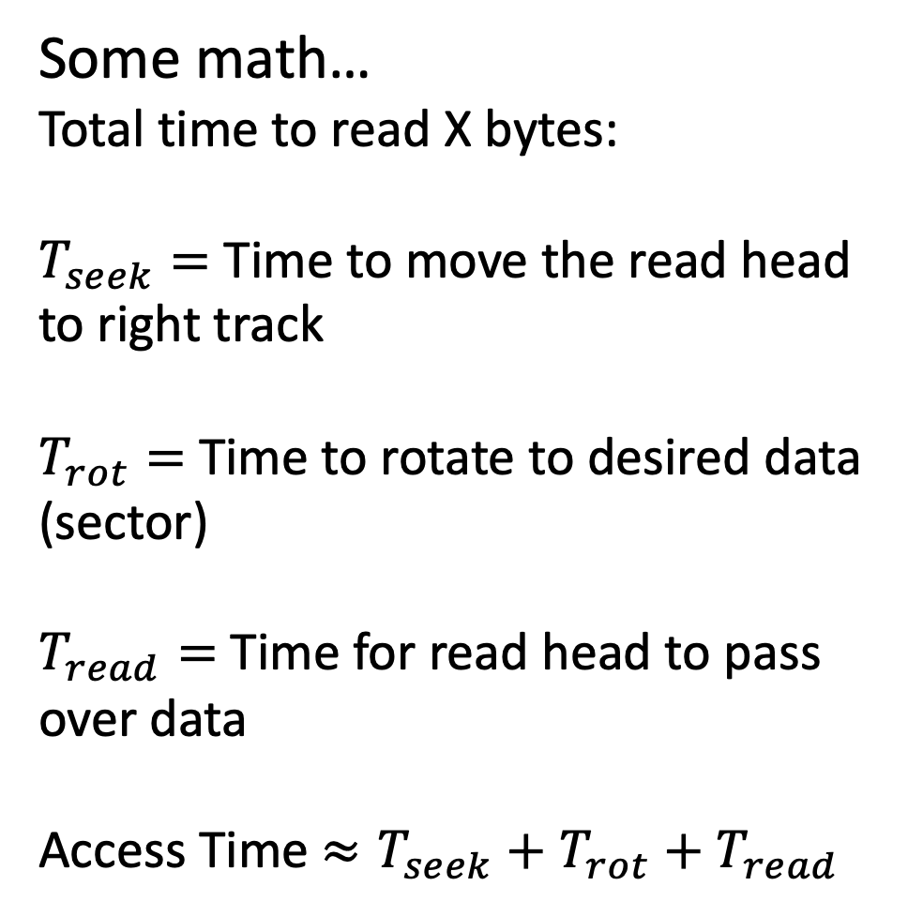
Spinning Rust
Platter, spinning @ 15k RPM
Some math…
Total time to read X bytes:
$T_{seek}=$ Time to move the read head to right track
$T_{rot}=$ Time to rotate to desired data (sector)
$T_{read}=$ Time for read head to pass over data
Access Time $≈T_{seek}+T_{rot}+T_{read}$

Slide 48
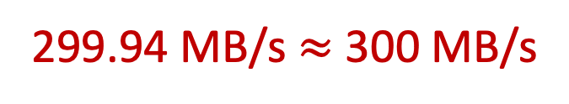
Spinning Rust
Platter, spinning @ 15k RPM
Some math…
-Average seek time: 2ms
-Average rotational time:
1/(15k RPM / 60)=4ms/rotation
we wait 2 ms on average
-Sequential read speed: 300 MB/s
To read 4KB of data:
2ms+ 2ms +.013 ms = 4.013ms
~1 MB/s
3GB of sequential data:
2ms+ 2ms + 10s = 10.002 s
299.94 MB/s $≈$ 300 MB/s

Slide 49
Spinning Rust
Platter, spinning @ 15k RPM
Sequential reading/writing of storage is essential
  2 orders of magnitude difference for HDD!
  Less difference for SSD, other reasons to write sequentially
Want to hide this from users
  Don’t want to think about this while writing queries
Want abstractions to help ourselves as system programmers

Slide 50
In This Course….
  Want data persistence and durable updates (storage), but also fast/complex data processing (memory)
  Want to process a drive worth of data (e.g. TB) using a server’s worth of memory (e.g. 64 GB)
  To leverage available compute, need concurrency at every level: intraquery, interquery, single-node, distributed database (multi-node)
  Want abstractions/architecture to hide hardware/system details from users
Lec. 3-4, Storage manager
Lec. 6, Memory mgmt.
Lec. 21, Recovery
Lec. 7-12, I/O optimized data structures, algorithms.
Lec. 13-15, Query Exec./Opt.
Lec. 16-19, Concurrency Control
Lec. 22-24, Distributed databases
Lec 1 - 2.5, Relational algebra, SQL
Lec 5, Storage Models
Lec 20, Logging

Slide 51
Next Class…
  The relational algebra (a brief history of databases)
    The basic data and programming model of a relational database
    Why an idea from 1969 is still popular today
    Some popular would-be alternatives

