Slide 1

Logistics
1
Bootcamp 2 will cover C++ needed for Project 1
We need Bootcamp 1 Feedback!

Slide 2
Lecture 3: Storage Manager

Slide 3
Logistics
3
Project 0 Due: TONIGHT (11:59) 9/3
Project 1 Releases 9/8
Sneak Preview
P1: Buffer Pool Manager
P2: B+ Tree
P3: Query Executor / Optimizer

Slide 4

Logistics
4
Bootcamp 2 RSVP (week of 9/15)

Slide 5
Last Class
5
We now understand what a database looks like at a logical level and how to write queries to read/write data (e.g., using SQL).
We will next learn how to build software that manages a database (i.e., a DBMS).

Slide 6
Course Outline
6
Relational Databases
Storage
Query Execution
Concurrency Control
Database Recovery
Distributed Databases
Potpourri
Application
SQL
Query Planning
Operator Execution
DBMS
Access Methods
Buffer Pool Manager
Disk Manager

Slide 7
Today's Agenda
7
Background
File Storage
Page Layout
Tuple Layout

Slide 8
Disk-based Architecture
8
The DBMS assumes that the primary storage location of the database is on non-volatile disk.
For computation, data needs to be brought into volatile memory.
The DBMS's components manage the movement of data between storage and memory.

Slide 9
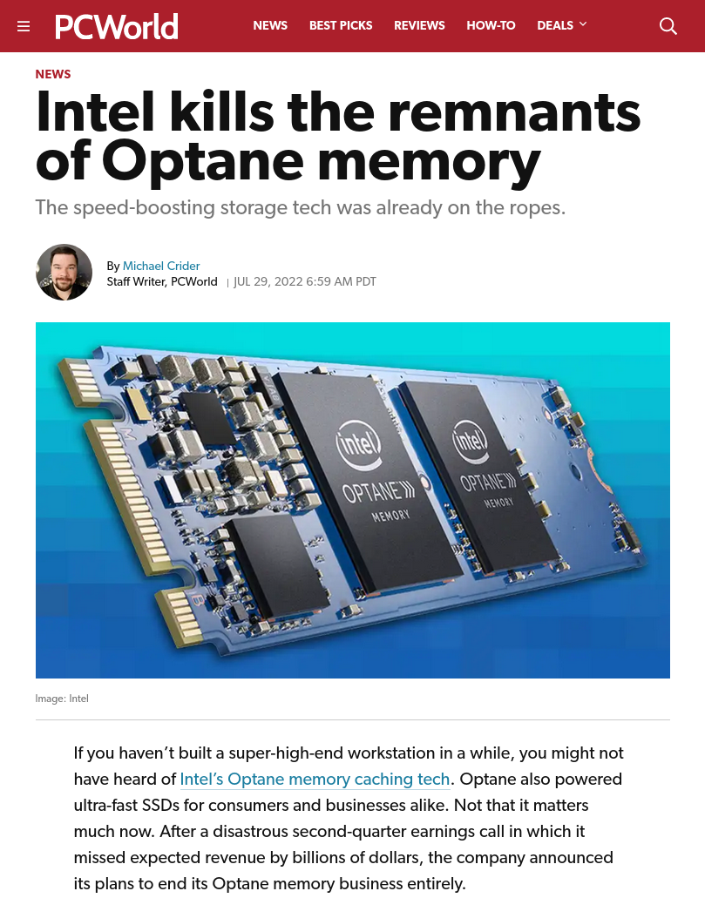
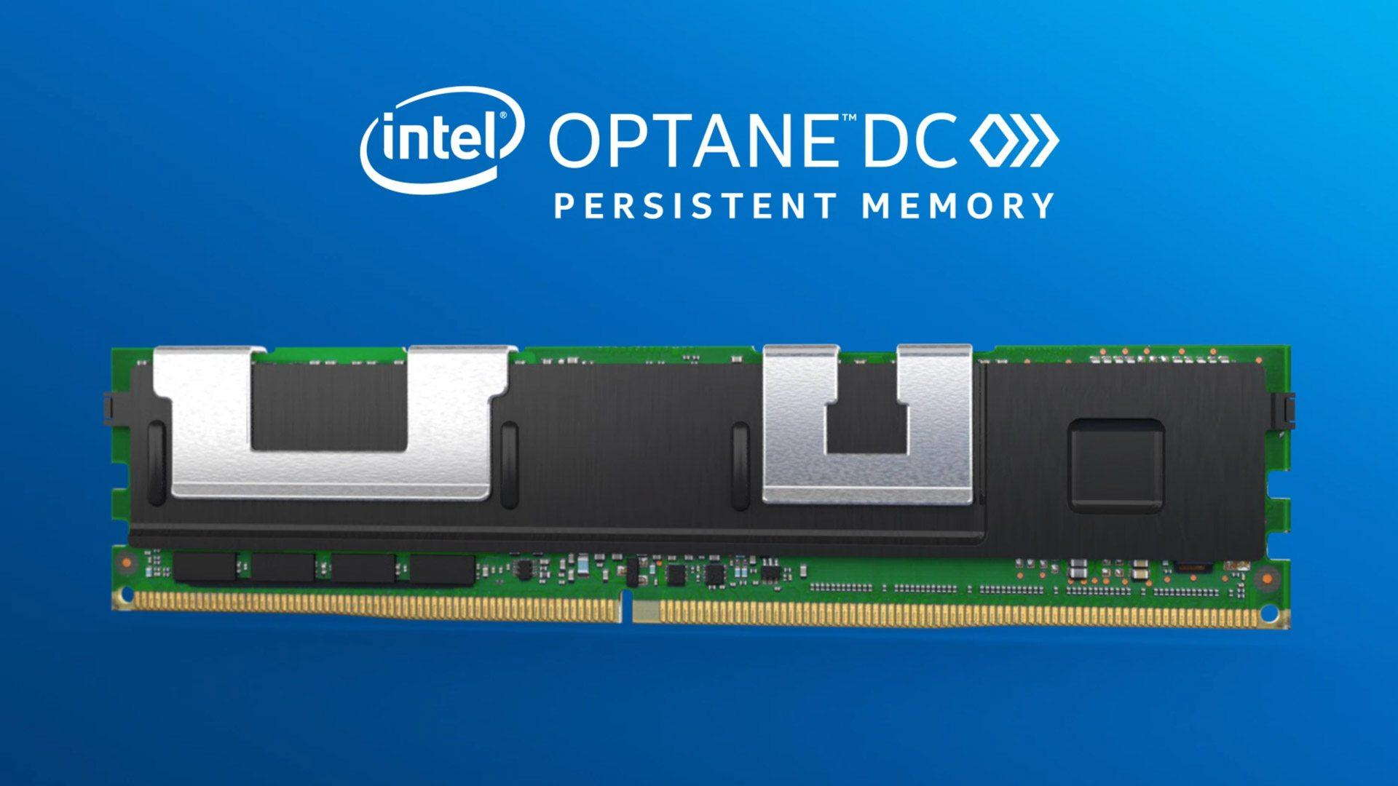
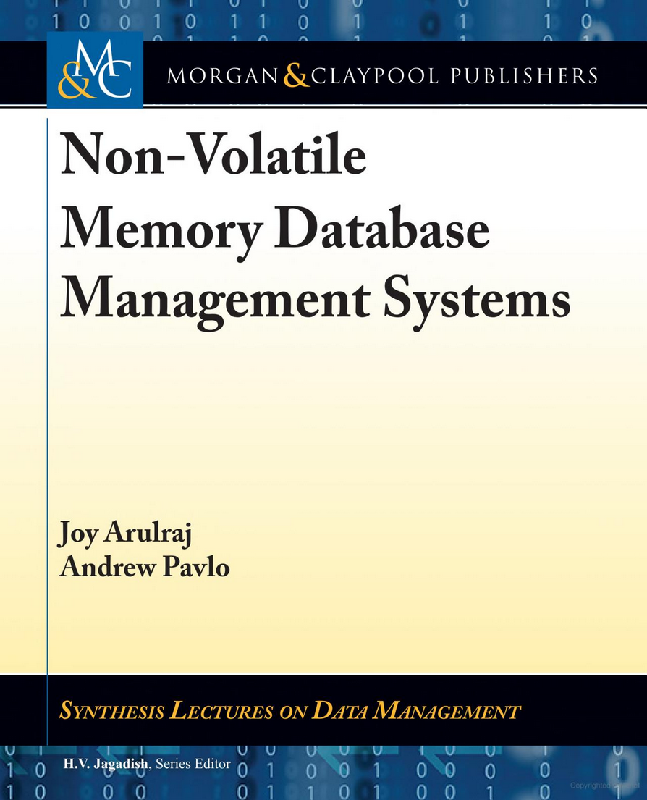
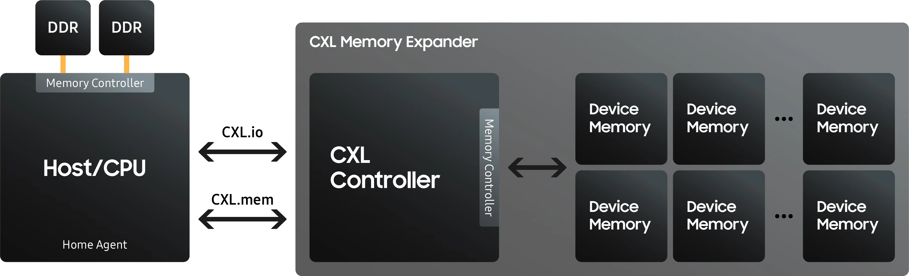

Storage Hierarchy
9
Faster
Smaller
Expensive
CPU Registers
CPU
CPU Caches
Volatile
Random Access
Byte-Addressable
Memory
DRAM
Persistent Memory
CXL Type 3
Non-Volatile
Sequential Access
Block-Addressable
SSD
Fast Network Storage
HDD
Disk
Slower
Larger
Cheaper
Network Storage

Slide 10
Access Times
10
Latency Numbers Every Programmer Should Know
1 ns | L1 Cache Ref
4 ns | L2 Cache Ref
100 ns | DRAM
16,000 ns | SSD
2,000,000 ns | HDD
~50,000,000 ns | Network Storage
1,000,000,000 ns | Tape Archives
1 sec
4 sec
100 sec
4.4 hours
3.3 weeks
1.5 years
31.7 years
Source: Colin Scott

Slide 11
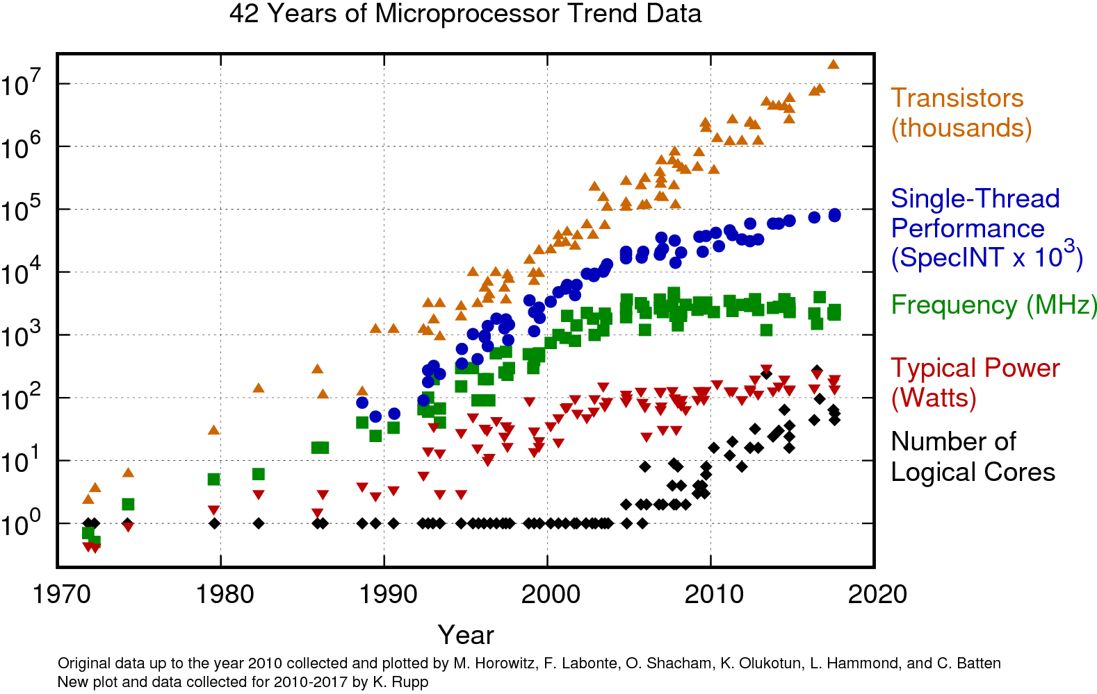
Hardware Trends
11
Transistor growth continues.
The question is how to use this hardware for DBMS performance.
Individual cores are not becoming faster, but there are more cores.
Every processor is now a “parallel” data machine, and the degree of parallelism is increasing.
https://www.karlrupp.net/2018/02/42-years-of-microprocessor-trend-data/

Slide 12
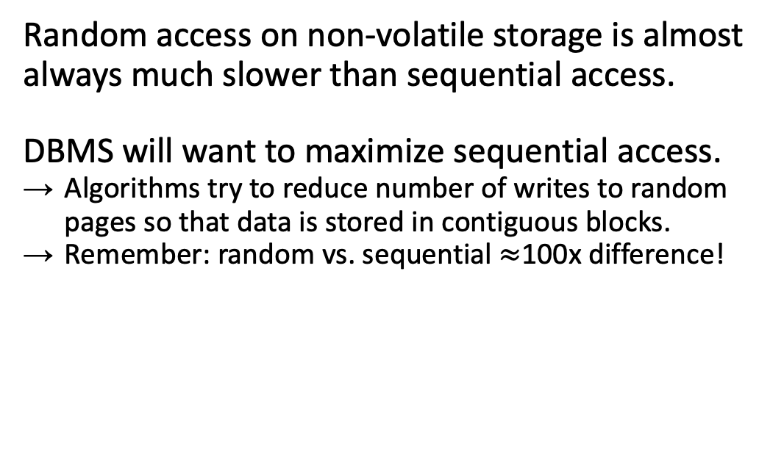
Sequential Vs. Random Access
12
Random access on non-volatile storage is almost always much slower than sequential access.
DBMS will want to maximize sequential access.
  Algorithms try to reduce number of writes to random pages so that data is stored in contiguous blocks.
  Remember: random vs. sequential $≈$100x difference!

Slide 13
System Design Goals
13
Reading/writing to disk is expensive, so it must be managed carefully to avoid large stalls and performance degradation.
Random access on disk is usually much slower than sequential access, so the DBMS will want to maximize sequential access.
Allow the DBMS to manage databases that exceed the amount of memory available.

Slide 14



Disk-oriented DBMS
14
Lectures #13-14
Get Page #2
Lecture #5
Execution
Engine
Directory
2
Pointer to Page #2
Header
Interpret Page #2 layout
Buffer Pool
Update Page #2
Memory
Lecture #5
…
Lectures #3-4
3
Header
5
1
Header
Header
2
Header
4
Directory
Header
Database File
Pages
Disk

Slide 15

The Dark Side
Goal: Allow the DBMS to manage databases that exceed the amount of memory available.
Idea: Let database "pretend" all data fits in memory, shuffle data in the background
Q: Can we leverage virtual memory to solve our problem?
A: Technically, yes, using mmap
Should

Slide 16

The Dark Side
Goal: Allow the DBMS to manage databases that exceed the amount of memory available.
Idea: Let database "pretend" all data fits in memory, shuffle data in the background
Q: Can we leverage virtual memory to solve our problem?
mmap
A: Technically, yes, using mmap
Should

Slide 17

Database Storage
17
Problem #1: How the DBMS represents the database in files on disk.
Problem #2: How the DBMS manages its memory and moves data back-and-forth from disk.
← Today
In-Memory DBMSs
15-721 – Spring 2019

Slide 18
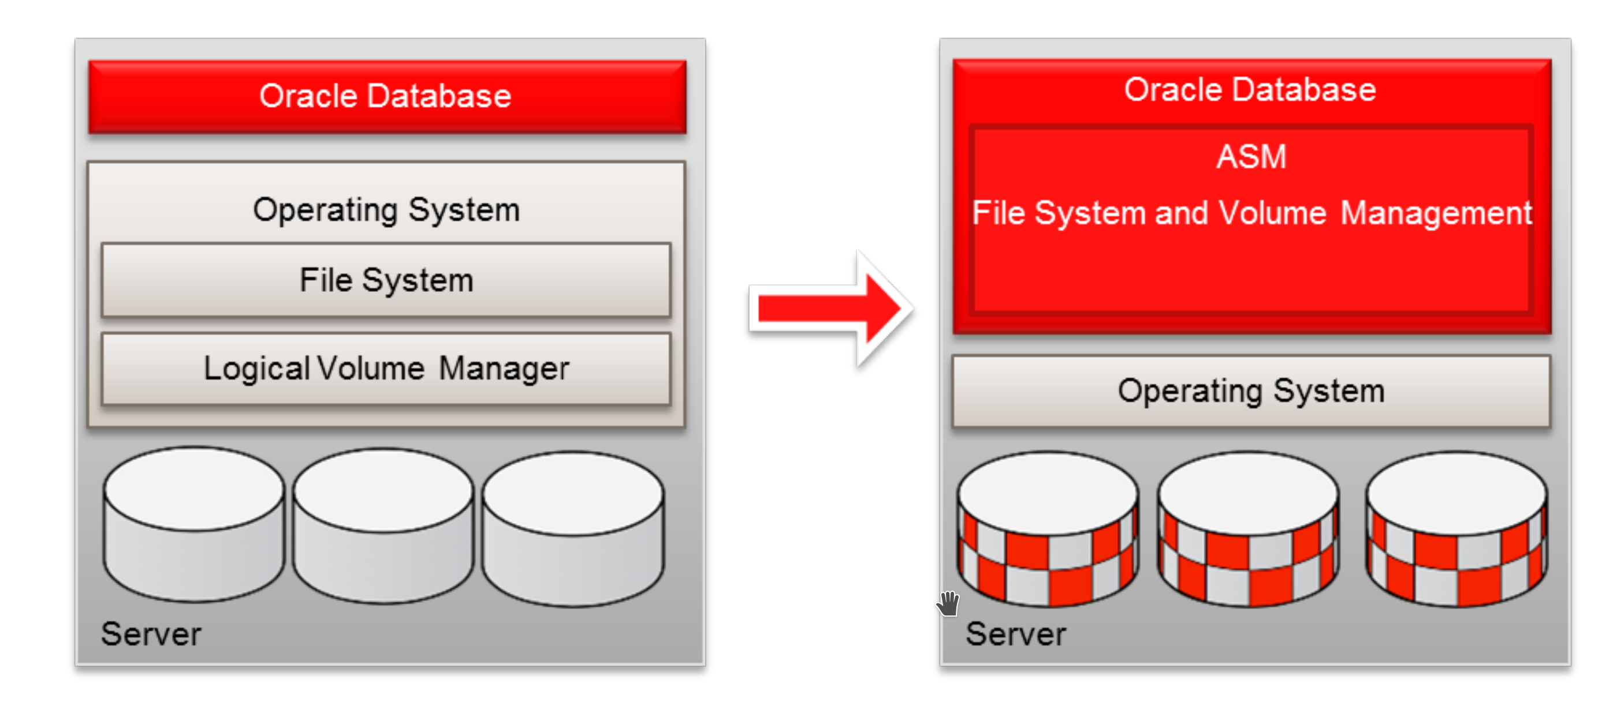
File Storage
18
The DBMS stores a database as one or more files on disk typically in a proprietary format.
  The OS does not know anything about the contents of these files.
  We will discuss portable file formats next week…
Early systems in the 1980s used custom filesystems on raw block storage.
  Some enterprise DBMSs still support this.
  Most newer DBMSs do not do this.

Slide 19
Storage Manager
19
The storage manager is responsible for maintaining a database's files.
  Some do their own scheduling for reads and writes to improve spatial and temporal locality of pages.
It organizes the files as a collection of pages.
  Tracks data read/written to pages.
  Tracks the available space.
A DBMS typically does not maintain multiple copies of a page on disk.
  Assume this happens above/below storage manager.

Slide 20
Database Pages
20
A page is a fixed-size block of data.
  It can contain tuples, meta-data, indexes, log records…
  Most systems do not mix page types.
  Some systems require a page to be self-contained.
Each page is given a unique identifier (page ID).
  A page ID could be unique per DBMS instance, per database, or per table.
  The DBMS uses an indirection layer to map page IDs to physical locations.

Slide 21








Database Pages
21
There are three different notions of "pages" in a DBMS:
  Hardware Page (usually 4KB)
  OS Page (usually 4KB, x64 2MB/1GB)
  Database Page (512B-32KB)
A hardware page is the largest block of data that the storage device can guarantee failsafe writes.
DBMSs that specialize in read-only workloads have larger page sizes.
Default DB Page Sizes
4KB
8KB
16KB

Slide 22
Page Storage Architecture
22
Different DBMSs manage pages in files on disk in different ways.
  Heap File Organization
  Tree File Organization
  Sequential / Sorted File Organization (ISAM)
  Hashing File Organization
At this point in the hierarchy, we do not need to know anything about what is inside of the pages.

Slide 23
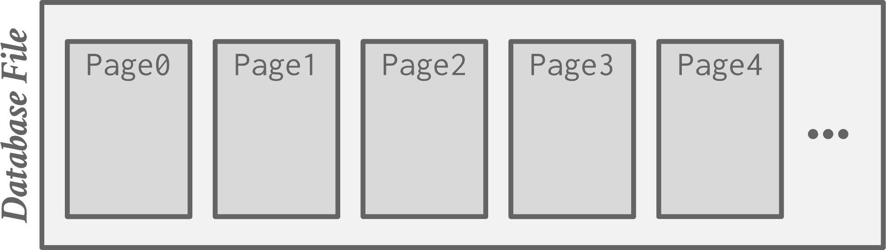
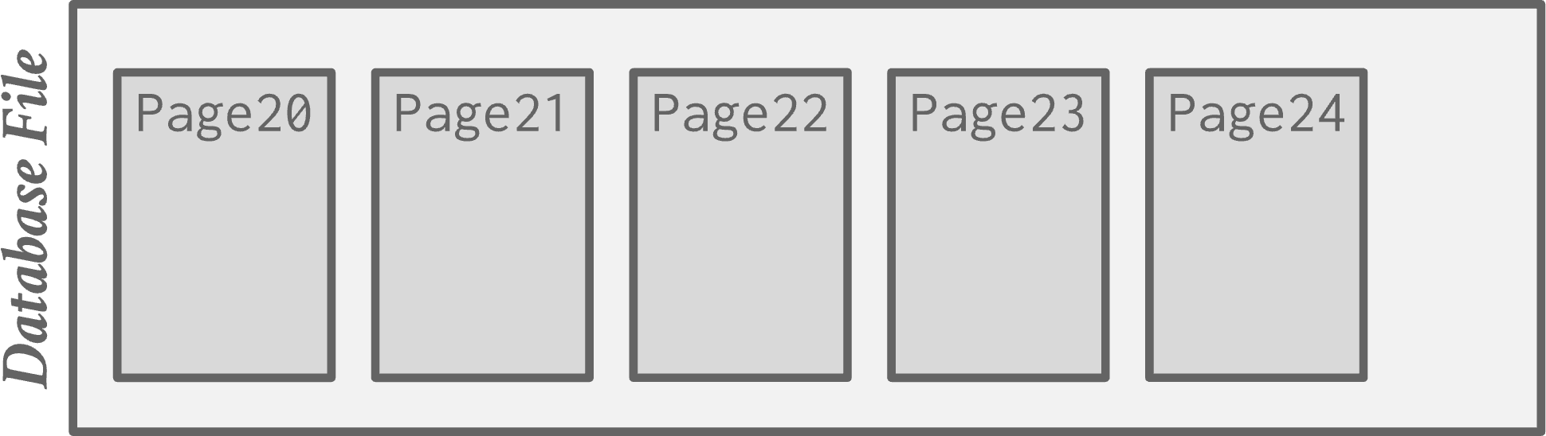


Heap File
23
A heap file is an unordered collection of pages with tuples that are stored in random order.
  Create / Get / Write / Delete Page
  Must also support iterating over all pages.
Need additional meta-data to track location of files and free space availability.
Offset = Page# × PageSize
File Location ▶ Page# × PageSize
Page0
Page1
Page2
Page3
Page4
…
Page Directory
Database File
Get Page #23
Get Page #2

Slide 24

Heap File: Page Directory
24
File 1
File 2
The DBMS maintains special pages that tracks the location of data pages in the database files.
  One entry per database object.
  Must make sure that the directory pages are in sync with the data pages.
DBMS also keeps meta-data about pages' contents:
  Amount of free space per page.
  List of free / empty pages.
  Page type (data vs. meta-data).
Page0
Page0
Directory
Data
Data
Table X
Index Y
Table Z
Page1
Page1
⋮
Data
Data
⋮
⋮

Slide 25
HEAP FILE: LINKED LIST
25
Maintain a header page at the beginning of the file that stores two pointers:
  HEAD of the free page list.
  HEAD of the data page list.
Each page keeps track of how many free slots they currently have.
Free Page
List
Page1
Page4
…
Header
Data
Data
Page0
Page2
…
Data Page
List
Data
Data

Slide 26
Today's Agenda
26
File Storage
Page Layout
Tuple Layout

Slide 27
Page Header
27
Every page contains a header of meta-data about the page's contents.
  Page Size
  Checksum
  DBMS Version
  Transaction Visibility
  Compression / Encoding Meta-data
  Schema Information
  Data Summary / Sketches
Some systems require pages to be self-contained (e.g., Oracle).
Page
Data
Header

Slide 28
Page Layout
28
For any page storage architecture, we now need to decide how to organize the data inside of the page.
  We are still assuming that we are only storing tuples in a row-oriented storage model.
Approach #1: Tuple-oriented Storage
Approach #2: Log-structured Storage
Approach #3: Index-organized Storage
Lecture #6
← Today
Lecture #4

Slide 29
Tuple-oriented Storage
29
How to store tuples in a page?
Strawman Idea: Keep track of the number of tuples in a page and then just append a new tuple to the end.
  What happens if we delete a tuple?
  What happens if we have a variable-length attribute?
Page
Num Tuples = 0
Num Tuples = 3
Num Tuples = 2
Tuple #1
Tuple #2
Tuple #4
Tuple #3

Slide 30

Slotted Pages
30
The most common layout scheme is called slotted pages.
The slot array maps "slots" to the tuples' starting position offsets.
The header keeps track of:
  The # of used slots
  The offset of the starting location of the last slot used.
Slot Array
1
2
3
4
5
6
7
Header
Tuple #4
Tuple #3
Tuple #2
Tuple #1
Fixed- and Var-length
Tuple Data

Slide 31
Record Ids
31
The DBMS assigns each logical tuple a unique record identifier that represents its physical location in the database.
  File Id, Page Id, Slot #
  Most DBMSs do not store ids in tuple.
  SQLite uses ROWID as the true primary key and stores them as a hidden attribute.
Applications should never rely on these IDs to mean anything.
CTID (6-bytes)
ROWID (8-bytes)
%%physloc%% (8-bytes)
ROWID (10-bytes)

Slide 32
Today's Agenda
32
File Storage
Page Layout
Tuple Layout

Slide 33
Tuple Layout
33
A tuple is essentially a sequence of bytes.
  These bytes do not have to be contiguous.
It is the job of the DBMS to interpret those bytes into attribute types and values.

Slide 34
Tuple Header
34
Each tuple is prefixed with a header that contains meta-data about it.
  Visibility info (concurrency control)
  Bit Map for NULL values.
We do not need to store meta-data about the schema.
Tuple
Header
Attribute Data

Slide 35
Tuple Data
35
Attributes are typically stored in the order that you specify them when you create the table.
This is done for software engineering reasons (i.e., simplicity).
However, it might be more efficient to lay them out differently.
Tuple
Header
a
b
c
d
e
CREATE TABLE foo (
a INT PRIMARY KEY,
b INT NOT NULL,
c INT,
d DOUBLE,
e FLOAT
);

Slide 36








Denormalized Tuple Data
36
DBMS can physically denormalize (e.g., "pre-join") related tuples and store them together in the same page.
  Potentially reduces the amount of I/O for common workload patterns.
  Can make updates more expensive.
Not a new idea.
  IBM System R did this in the 1970s.
  Several NoSQL DBMSs do this without calling it physical denormalization.
foo
…
Header
a
b
CREATE TABLE foo (
a INT PRIMARY KEY,
b INT NOT NULL,
);
c
c
c
foo
bar
CREATE TABLE bar (
c INT PRIMARY KEY,
a INT
⮱REFERENCES foo (a),
);
bar
Header
c
a
SELECT * FROM foo JOIN bar
ON foo.a = bar.a;
Header
c
a
Header
c
a

Slide 37
Conclusion
37
Database is organized in pages.
Different ways to track pages.
Different ways to store pages.
Different ways to store tuples.

Slide 38
Next Class
38
Log-Structured Storage
Index-Organized Storage
Value Representation
Catalogs

Slide 39
Page0
Page1
Page2
Page3
Page4
…
Database File
Page20
Page21
Page22
Page23
Page24
…
Database File
Page10
Page11
Page12
Page13
Page14
…
Database File
Page30
Page31
Page32
Page33
Page34
…
Database File

